Slide 1
DBMS and
RDBMS

Slide 2
Data and Database
Data means any raw facts. And Information is the collection of related data.
Data means information and it is the most important component in any work that is done.
A database is a collection of data.
Thus, a database is a collection of data that is organized such that its contents can be easily accessed, managed, and updated.
Stores Information
Database
Users
Allows to Access Information

Slide 3

Data Management
Data management deals with managing large amount of information, which involves both the storage of information and the provision of mechanisms for the manipulation of information.
The two different approaches of managing data are:
  File-based systems
  Database systems

Slide 4



File-based systems 1-3
Features of file-based systems:
Systems in which data was stored
in discrete files.
In this system, a bunch of files was stored on a computer and could be accessed by a computer operator.

Slide 5

File-based systems 2-3
Example
The Sales database will contain the following tables:
  PropertyForRent (PropertyNo, Address, Type, Rent, OwnerNo)
  PrivateOwner (OwnerNo, Name, Address, TelNo)
  Client (ClientNo, Name, Address, TelNo, PrefType, MaxRent)
Sales
Database
Data entry and reports
File handling routines

Slide 6


File-based systems 3-3
Disadvantages of File-based Systems are:
  Data Redundancy and Inconsistency
  Unanticipated Queries
  Data Isolation
  Concurrent Access Anomalies
  Security Problems
  Integrity Problems

Slide 7
Database systems
Databases are used to store data in an efficient and organized manner, which allows quick and easy management of data.
Advantages of database systems are:
  The amount of redundancy in the stored data can be reduced
  No more inconsistencies in data
  The stored data can be shared
  Standards can be set and followed
  Data Integrity can be maintained
  Security of data can be implemented

Slide 8
Database Management System (DBMS) 1-2
It is a collection of related records and a set of programs that access and manipulate these records.
DBMS provides an environment that is both convenient and efficient to use when there is a large volume of data and many transactions to be processed.
It enables the users to define, create, and maintain the database and provides controlled access to this database.
Different DBMS support different query languages, although there is a semi-standardized query language called SQL (Structured Query Language).

Slide 9
Benefits of DBMS
The benefits of typical DBMS are as follows:
  Data Storage
  Data Definition
  Data Manipulation
  Data Security and Integrity
  Data Recovery and Concurrency
  Performance
  Database Access Languages and Application Programming Interfaces

Slide 10
Database Models 1-5
Databases can be differentiated based on functions and model of the data.
A data model describes a container for storing data, and the process of storing and retrieving data from that container.

Slide 11



Database Models 2-5
- Hierarchical model
- Network model
- Relational model

Slide 12



Database Models 3-5
The different types of data models are:
  Flat-file Data model
    This model is used for simple databases. The database consists of only one table or file.
  Hierarchical Model
    Records are inter-related through hierarchical or tree-like structures.
    In this model, relationships are thought of in terms of children and parents. A parent record can have several children, but a child can have only one parent.

Slide 13
Database Models 4-5
  Network Data Model
    It is similar to the Hierarchical Data Model.
    The hierarchical model is actually a subset of the network model.
    The network model uses set theory to provide a tree-like hierarchy with the exception that child tables were allowed to have more than one parent.
    Data is stored in sets, instead of the hierarchical tree format. This solves the problem of data redundancy.

Slide 14
Database Models 5-5
  Relational Data Model:
In the Relational Model, there are no physical links. All data
is maintained in the form of tables consisting of rows and
columns.
Data in two tables is related through common columns.
Operators are provided for operating on rows in tables.
This model represents the database as a collection of
relations. In this model’s terminology, a row is called a
tuple, a column an attribute and the table is called a
relation. The list of values applicable to a particular field is
called domain.

Slide 15
Relational Database Management System (RDBMS)
A Relational Database Management System (RDBMS) is a database management system where all data visible to the user is organized strictly as tables of data values, and where all database operations take place on these tables.
A relational database is a database divided into logical units called tables, where tables are related to one another within the database.
Relationship
TABLE 1
Key
Data...
TABLE 2
Key
Data...
Database

Slide 16
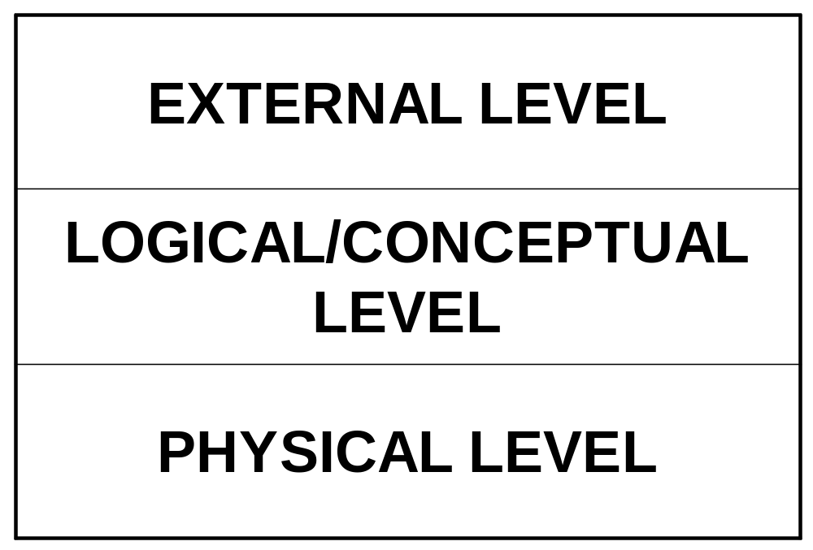
Layered database architecture
Notes:
External Level: It is the individual user level. The user may be an application programmer or an end user. Use of a data sublanguage is required.
It is represented by views.
Conceptual/Logical Level – It contains the representation of data. This view represents the data as it really is which is different from the external level in the sense that at the external level the users are forced to see the data imposed by some restrictions.
Physical Level – It’s a low level representation of the entire database. Consist of the actual files where the data is stored. Generally it is to be dealt by only the DBA.

Slide 17
Terms related to RDBMS
Term | Meaning
Relation | A table
Tuple | A row or a record in a relation
Attribute | A field or a column in a relation
Cardinality of a relation | The number of tuples in a relation
Degree of a relation | The number of attributes in a relation
Domain of an attribute | The set of all values that can be taken by the attribute

Slide 18
These terms are mostly used in RDBMS:
  Data is presented as a collection of relations.
  Each relation is depicted as a table.
  Columns are attributes.
  Rows (“tuples”) represent entities.
  Every table has a set of attributes that are taken together as a “key” (technically, a “superkey”), which uniquely identifies each entity.

Slide 19
Table
Attributes
Emp_No | Emp_Name | Emp_DOB | Emp_DOJ
345 | James | 24-Sep-1968 | 30-May-1990
873 | Pamela | 27-Jul-1970 | 19-Nov-1993
693 | Allan | 10-Sep-1970 | 01-Jul-1992
305 | Geoff | 12-Feb-1973 | 29-Oct-1996
Tuple

Slide 20
Keys
A key is an attribute (also known as column or field) or a combination of attribute that is used to identify records.
Super Key – An attribute or a combination of attribute that is used to identify the records uniquely is known as Super Key.

Slide 21
Continue...
Candidate Key – It can be defined as minimal Super Key or irreducible Super Key. In other words an attribute or a combination of attribute that identifies the record uniquely but none of its proper subsets can identify the records uniquely.

Slide 22
Continue...
Primary Key – A Candidate Key that is used by the database designer for unique identification of each row in a table is known as Primary Key.
On single table we can create only one primary key.
Primary key will not allow duplicate as well as null value.

Slide 23
Continue...
Foreign Key – A foreign key is an attribute or combination of attribute in one base table that points to the candidate key (generally it is the primary key) of another table or same table.
Foreign Key allow duplicate record but only those record which present in primary key.
It allow null value.

Slide 24
Continue...
Composite Key – If we use multiple attributes to create a Primary Key then that Primary Key is called Composite Key (also called a Compound Key or Concatenated Key).
Alternate Key – Alternate Key can be any of the Candidate Keys except for the Primary Key.

Slide 25
Continue...
Secondary Key – The attributes that are not even the Super Key but can be still used for identification of records (not unique) are known as Secondary Key.
Surrogate key: : It is created to be the record’s primary key identifier when no suitable primary key exists. In an Oracle database, you can automatically generate surrogate key values using a sequence.

Slide 26
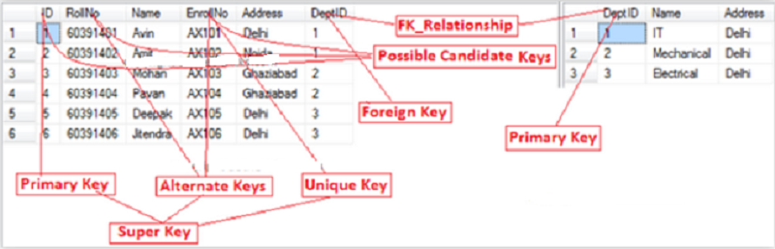

Slide 27


Users of RDBMS
Database
Administrators
End Users
Application Programmers

Slide 28



The E-R Model(1)
It is a ‘conceptual model’ of the database
Here, a system is composed of related entities
Tables identified
Database Designer
End User

Slide 29






Components of E-R Model
Entity
Attributes
A description
A Property
Relationship

Slide 30
Entity-Relationship (ER) model 1-4
Data models can be classified into three different groups:
  Object-based logical models
  Record-based logical models
  Physical models
The Entity-Relationship (E-R) model belongs to the first classification. The model is based on a simple idea. Data can be perceived as real world objects called entities and the relationships that exist between them.
An E-R model consists of five basic components. They are:
  Entity
  Relationship
  Attributes
  Entity Set
  Relationship Set
Employee Entity Set
Department Entity Set
€
€
€
€
€
Relationship Set
€
Human Resource
€
€
€
€
works in
Production
€
€
€
€
€
Accounts
Logistics
Department Entities
Employee Entities

Slide 31
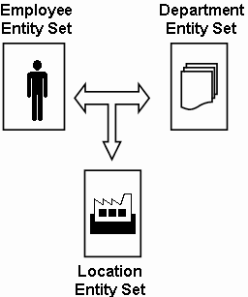
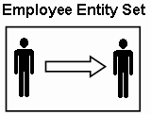
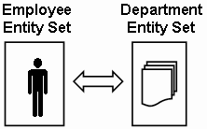
Entity-Relationship (ER) model 2-4
Relationships associate one or more entities. They can be of three types:
  Self relationships: Relationships between entities of the same entity set are called self relationships.
  Ternary relationships: Relationships that exist between three entities of different entity sets are called ternary relationships.
  Binary relationships: Relationships that exist between entities of two different entity sets are called binary relationships.

Slide 32
Entity-Relationship (ER) model 3-4
Relationships can also be classified as per mapping cardinalities. The different mapping cardinalities are:
  One-to-One: This kind of mapping exists when an entity of one entity set can be associated with only one entity of another set.
  One-to-Many: This kind of mapping exists when an entity of one set can be associated with more than one entity of another entity set.
Vehicle Entity Set

Vehicle Entity Set
 
 
 
Registration Entity Set
Customer Entity Set

 
€
 
 
registration


Slide 33
Entity-Relationship (ER) model 4-4
  Many-to-One: This kind of mapping exists when many entities of one set is associated with an entity of another set. This association is done irrespective of whether the latter entity is already associated to other or more entities of the former entity set.
  Many-to-Many: This kind of mapping exists when any number of entities of one set can be associated with any number of entities of the other entity set.
Vehicle Entity set

 
 
 
Location Entity set
Customer Entity Set
Account Entity Set

€
 
☞
€


Slide 34
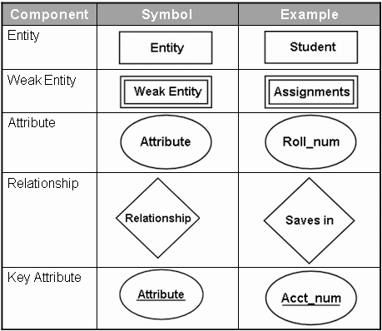
Entity-Relationship Diagrams
The E-R diagram is a graphical representation of the E-R model.
The symbols used for the various components can be seen in the following table:

Slide 35
Entity-Relationship Diagrams
Steps to construct an E-R diagram are:
  Gather all the data that needs to be modeled.
  Identify data that can be modeled as real world entities.
  Identify the attributes for each entity.
  Sort entity sets as weak or strong entity sets.
  Sort entity attributes as key attributes, multi-valued attributes, composite attributes, derived attributes.
  Identify the relations between the different entities.
  Using the different symbols draw the entities, their attributes and their relationships. Use appropriate symbols while drawing attributes.

Slide 36
Normalization

Slide 37
Normalization
The biggest problem needed to be solved in database is data redundancy.
Why data redundancy is the problem? Because it causes:
  Insert Anomaly
  Update Anomaly
  Delete Anomaly

Slide 38
What is an Anomaly?
Definition
  Database anomaly is normally the flaw in databases which occurs because of poor planning and storing everything in a flat database(single table).
  3 types
    Insert
    Delete
    Update

Slide 39
Insert Anomaly
An Insert Anomaly occurs when certain attributes cannot be inserted into the database without the presence of other attributes.

Slide 40
Insert Anomaly
Course _no | Trainer | Room | Room_size | En_limit
C001 | Raj | R001 | 45 | 40
C002 | Seeta | R002 | 100 | 60
C003 | Meeta | R003 | 400 | 300
C004 | Veeta | R003 | 400 | 45
e.g. we have built a new room (e.g. R004) but it has not yet been timetabled for any courses or members of staff.

Slide 41
Delete Anomaly
A Delete Anomaly exists when certain attributes are lost because of the deletion of other attributes.

Slide 42
Delete Anomaly
Course_no | Tutor | Room | Room_size | En_limit
C001 | Raj | R001 | 45 | 40
C002 | Seeta | R002 | 100 | 60
C003 | Meeta | R003 | 400 | 300
C004 | Veeta | R003 | 400 | 45
e.g. if we remove the entity, course_no:C004 from the above table, the details of room R001 get deleted. Which implies the corresponding course will also get deleted.

Slide 43
Update Anomaly
An Update Anomaly exists when one or more instances of duplicated data is updated, but not all.

Slide 44
Update Anomaly
Course_no | Trainer | Room | Room_size | En_limit
C001 | Raj | R001 | 45 | 40
C002 | Seeta | R002 | 100 | 60
C003 | Meeta | R003 | 400 | 300
C004 | Veeta | R003 | 400 | 45
e.g. Room R003 has been improved, it is now of RSize = 500. For updating a single entity, we have to update all other columns where room=R003.

Slide 45
Normalization (Cont.)
Normalization is the process of removing redundant data from your tables to improve storage efficiency, data integrity, and scalability.
Normalization generally involves splitting existing tables into multiple ones, which must be re-joined or linked each time a query is issued.
Why normalization?
  The relation derived from the user view or data store will most likely be unnormalized.
  The problem usually happens when an existing system uses unstructured file, e.g. in MS Excel.

Slide 46
Steps of Normalization
First Normal Form (1NF)
Second Normal Form (2NF)
Third Normal Form (3NF)
Boyce-Codd Normal Form (BCNF)
Fourth Normal Form (4NF)
Fifth Normal Form (5NF)
In practice, 1NF, 2NF, and 3NF are enough for database.

Slide 47
First Normal Form (1NF)
The official qualifications for 1NF are:
  Each attribute name must be unique.
  Each attribute value must be single.
  Each row must be unique.
  There is no repeating groups.
Additional:
  Choose a primary key.
Reminder:
A primary key is unique, not null, unchanged. A primary key can be either an attribute or combined attributes.

Slide 48
First Normal Form (1NF) (Cont.)
Example of a table not in 1NF :
It violates the 1NF because:
Attribute values are not single.
Repeating groups exists.
Group | Topic | Student | Score
Group A | Intro MongoDB, Oracle | Raj Deep | 18 marks
 |  | Ram Kumar | 28 marks
 |  | Seeta Kumari | 17 marks
Group B | Intro MySQL | Ram Patil | 19 marks
 |  | Veeta Roy | 16 marks

Slide 49
First Normal Form (1NF) (Cont.)
After eliminating:
Group | Topic | First Name | Last Name | Score
A | Intro MongoDB | Raj | Deep | 18
A | Intro MongoDB | Seeta | Kumari | 17
A | Oracle | Raj | Deep | 18
A | Oracle | Seeta | Kumari | 17
B | Intro MySQL | Ram | Patil | 19
B | Intro MySQL | Veeta | Roy | 16

Slide 50
First Name | Last Name | Score | GroupId
Raj | Deep | 18 | A
Seeta | Kumari | 17 | A
Ram | Patil | 19 | B
Veeta | Roy | 16 | B
Raj | Deep | 18 | C
Seeta | Kumari | 17 | C
Group | Technology
A | Intro Mongo DB
B | Intro MySQL
C | Oracle
Now it is in 1NF.
However, it might still violate 2NF and so on.

Slide 51
Functional Dependencies
We say an attribute, B, has a functional dependency on another attribute, A, if for any two records, which have
the same value for A, then the values for B in these two records must be the same. We illustrate this as:
  A → B (read as: A determines B or B depends on A)
Employee name | Project | Email address
Raj Deep | Java | raj@gmail.com
Seeta Kumari | .net | seeta@gmail.com
Ram Patil | HTML5/CSS3 | ram@gmail.com
Veeta Roy | Database | veeta@gmail.com
Raju Patel | DB Design | raju@gmail.com
    Employee name → Email address
    Employee name determines Email Address
    Email Address depends on Employee name

Slide 52
Functional Dependencies (cont.)
EmpNum
EmpEmail
EmpFname
EmpLname
123
raj@gmail.com
Raj
Deep
456
seeta@gmail.com
Seeta
Kumari
555
ram@gmail.com
Ram
Patil
633
veeta@gmail.com
Veeta
Roy
787
raju@gmail.com
Raju
Patel
If EmpNum is the PK then the FDs:
EmpNum → EmpEmail, EmpFname, EmpLname
must exist.

Slide 53
Functional Dependencies (cont.)
EmpNum → EmpEmail, EmpFname, EmpLname
3 different ways you might see FDs depicted
EmpEmail
EmpNum
EmpFname
EmpLname
EmpNum EmpEmail EmpFname EmpLname

Slide 54
Determinant
Functional Dependency
EmpNum → EmpEmail
Attribute on the left hand side is known as the determinant
  EmpNum is a determinant of EmpEmail

Slide 55
Second Normal Form (2NF)
The official qualifications for 2NF are:
A table is already in 1NF.
All non-key attributes are fully dependent on the primary key.
All partial dependencies are removed to place in another table.
12

Slide 56
Example of a table not in 2NF:
CourseID | SemesterID | Num Student | Course Name
IT101 | 201301 | 25 | Database
IT101 | 201302 | 25 | Database
IT102 | 201301 | 30 | Web Prog
IT102 | 201302 | 35 | Web Prog
IT103 | 201401 | 20 | Networking
Primary Key(Composite Key)
The Course Name depends on only CourseID, a part of the primary key
not the whole primary {CourseID, SemesterID}.It’s called partial dependency.
Solution:
Remove CourseID and Course Name together to create a new table.

Slide 57
CourseID | Course Name
IT101 | Database
IT101 | Database
IT102 | Web Prog
IT102 | Web Prog
IT103 | Networking
CourseID | SemesterID | Num Student
IT101 | 201301 | 25
IT101 | 201302 | 25
IT102 | 201301 | 30
IT102 | 201302 | 35
IT103 | 201401 | 20
Done? Oh no, it is still not in 1NF yet.
Remove the repeating
groups too.
Finally, connect the relationship.
Semester
CourseID | Course Name
IT101 | Database
IT102 | Web Prog
IT103 | Networking

Slide 58
CS_ID(PK) | CourseID(FK) | SemesterID(FK) | Num Student
CS001 | IT101 | 201301 | 25
CS002 | IT101 | 201302 | 25
CS003 | IT102 | 201301 | 30
CS004 | IT102 | 201302 | 35
CS005 | IT103 | 201401 | 20
Semester
SemesterID(PK) | Semester
201301 | I
201302 | II
201401 | III
201402 | IV
201501 | V
CourseID(PK) | Course Name
IT101 | Database
IT102 | Web Prog
IT103 | Networking

Slide 59
Third Normal Form (3NF)
The official qualifications for 3NF are:
A table is already in 2NF.
Nonprimary key attributes do not depend on other nonprimary key attributes
(i.e. no transitive dependencies)
  All transitive dependencies are removed to place in another table.

Slide 60
Example of a Table not in 3NF:
TeacherID | Teacher Name | Teacher Tel | Course Name
1 | Raj Deep | 012 123 456 | Database
2 | Seeta Kumari | 0977 322 111 | Database
3 | Ram Patil | 012 412 333 | Web Prog
4 | Seeta Kumari | 0977 322 111 | Web Prog
5 | Raj Deep | 012 123 456 | Networking
The Teacher Tel is a nonkey attribute, and
the Teacher Name is also a nonkey atttribute.
But Teacher Tel depends on Teacher Name.
It is called transitive dependency.
Primary Key
Solution:
Remove Teacher Name and Teacher Tel together
to create a new table.

Slide 61
Done?
Oh no, it is still not in 1NF yet.
Remove Repeating row.
Teacher Name | Teacher Tel
Raj Deep | 012 123 456
Seeta Kumari | 0977 322 111
Ram Patil | 012 412 333
Veeta Roy | 012 412 333
Raj Deep | 012 123 456
Seeta Kumari | 0977 322 111
StudyID | Course Name | T.ID(FK)
1 | Database | T1
2 | Database | T2
3 | Web Prog | T3
4 | Web Prog | T3
5 | Networking | T4
Teacher Name | Teacher Tel
Raj Deep | 012 123 456
Seeta Kumari | 0977 322 111
Ram Patil | 012 412 333
Veeta Roy | 077 545 221
Note about primary key:
In theory, you can choose
Teacher Name to be a primary key.
But in practice, you should add
Teacher ID as the primary key.
ID(PK) | Teacher Name | Teacher Tel
T1 | Raj Deep | 012 123 456
T2 | Seeta Kumari | 0977 322 111
T3 | Ram Patil | 012 412 333
T4 | Veeta Roy | 077 545 221

Slide 62
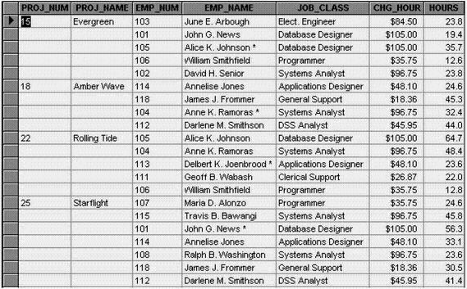

Slide 63
When to use Normalization??
When data is large and scattered
There is no defined group of data
Data is too complicated
The first step to build the database application

Slide 64
Denormalisation
Normalization has some drawbacks.
Joins with multiple tables affects the performance of the database. The CPU time required to solve such queries will be very large. In such cases, storing a few fields redundantly can be considered to increase the performance of the database. Such a database is said to be a Denormalised database.

Slide 65
ACID Properties of a Database (1 of 4)
  ACID – are four properties that define the required characteristic of a database to make it reliable.
  A (Atomicity): This property of a database guarantees that an action is only executed on the database when all of its related actions are successfully executed.
  Transaction – It is a set of interrelated activities in a database, wherein all must be completed for it to be successful.
  Example: Steps for purchasing an item from a store:
    Select the item to be purchased.
    Pay the cashier the amount.
    Get the item and bring home.
Notes:
Copyright © 2014 Accenture All Rights Reserved.
Focus: ACID Properties of a Database (1 of 4)
Content: In the real-life example, if the person does not pay the cashier, then s/he cannot get the item. If s/he is not able to get the item (let’s say there is no more available stock), then the payment should be returned.
Note to Instructor: The focus here of these slides is to define the ACID properties of a database. This is key to understanding further database concepts. The first property is atomicity.
Transition: Moving forward to view an example of atomicity property of a database.

Slide 66
Example of Atomicity
CASH-
ON-HAND
1
2
50 - 5
0 + 5
EXPENSES
50
0
Lunch = $5
3
ERROR OCCURS
4
0 + 5
50 - 5
STOP!!!
5
Error Message to
User
6
CASH-
ON-HAND
EXPENSES
50
0
Notes:
Copyright © 2014 Accenture All Rights Reserved.
Focus: Example of Atomicity
Content:
You have a database for your cash-on-hand and expenses which initially has the value of $50 for cash-on-hand and $0 for expenses.
If one spends $5 for lunch, then s/he should subtract $5 from cash-on-hand and add $5 to his expenses.
If for some technical reason, the $5 cannot be deducted from the cash-on-hand (e.g. database got locked), then the $5 would not be allowed to be added on expenses and an error message is sent to the user of the system.
The cash-on-hand and expenses should retain their original values of $50 and $0 respectively.
The user has to figure first why the error occurred, fix the cause (unlock the database), and then attempt to complete the transaction again.
Note to Instructor: This slide shows how atomicity works in a storyboard manner.
Transition: Now, the next property of a database.

Slide 67
ACID Properties of a Database (2 of 4)
C (Consistency): This property of a database guarantees that data residing inside a database is always consistent with the rules that have been set on the database. Any action on the database should also follow the rules; otherwise, it will not be allowed.
Example: If you have a Social Security Number Database for the company employees, the database should have a rule that it should not allow entry of a duplicate Social Security Number. An error message will be given to the user.
Notes:
Copyright © 2014 Accenture All Rights Reserved.
Focus: ACID Properties of a Database (2 of 4)
Content: Another possible example is when a database should not accept non-numeric characters in the age field of a person. An age field should always be a number.
Note to Instructor: Define consistency and describe how this property is related to database.
Transition: Let’s look at an example of consistency.

Slide 68
Example of Consistency
1
2
15323
15323
15323
insert
Social Security
Database
3
4
Error
Message
to User
15323
Social Security
Database
Notes:
Copyright © 2014 Accenture All Rights Reserved.
Focus: Example of Consistency
Content:
The social security database of a company has the entry 15323, which is defined as unique in the database because no two employees could have the same Social Security Number.
A user of the system mistakenly encoded the same social security number for another employee. The database blocks the insert.
An error message is sent back to the user informing him/her that a duplicate insertion was attempted.
The social security database remains the same. There will still be only one entry of 15323 in the database.
Note to Instructor: Explain the example related to consistency.
This slide shows how consistency works in a storyboard manner.
Transition: Going forward to the isolation property.

Slide 69
ACID Properties of a Database (3 of 4)
  I (Isolation): This property of database guarantees that while you are updating a piece of data, everyone else trying to access (i.e., read) the same data will see the original version of the data. This means that other users will be isolated from seeing changes in an intermediate state. To implement isolation, it also means that the database can do ‘locking.’
  Locking – It means preventing another person from updating or deleting data when someone is already updating or deleting the data.
  Example: Microsoft® SharePoint implements isolation and locking. If someone ‘checks out’ a document and starts editing, everyone who tries to view the same document will see the old version of the document (isolation). Also, no one can edit the same document while the document is checked out (locking). Only after he/she ‘checks in’ the document, will others be able to see the edits and update the same document. In database terms, checking in a document in Microsoft SharePoint is equivalent to the term commit.
Notes:
Copyright © 2014 Accenture All Rights Reserved.
Focus: ACID Properties of a Database (3 of 4)
Content: NA
Note to Instructor: Define isolation and describe how this property is related to database.
Transition: Let’s move to the example of isolation property.

Slide 70
Example of Isolation
PRODUCT PRICE
150
1
2
150
180
Manager 1
3
User 1
150
4
150
M2
150
Error Message
to M2
M1
User 2
150
M1
5
6
User 1
180
COMMIT
180
M1
180
M2
User 2
180
Notes:
Copyright © 2014 Accenture All Rights Reserved.
Focus: Example of Isolation
Content:
You have a product price database that has an original value of $150 for a certain product.
Manager 1 (M1) decides to increase the price to $180. While doing the update, he has a lock on the price value.
While still completing the updates, other users try to view the current price of the product. Users will still see the original price of $150.
If Manager 2 (M2) attempts to update the price while M1 is still in the process of doing so, the database will not allow him to and will send M2 an error message saying that the record is locked.
Once M1 commits his changes, the database writes on the database and changes the price of the product to $180.
It is only then at this time that users can see the price change made by M 1. They will now see that the price of the product is already $180.
Also at this time, M2 can now freely update the value of the price if he desires.
Note to Instructor: Explain the example related to isolation.
This slide shows how isolation works in a storyboard manner.
Transition: Moving to the durability property.

Slide 71
ACID Properties of a Database (4 of 4)
  D (Durability): This property of database guarantees that once a user is notified of success in his action on the database, the completed action will persist. This still could be changed however, by a succeeding independent action.
  Example: You updated your user profile in a database through an online entry system. After being notified of a successful update, the power supply of the entire building went down, including the database. A database should normally be able to recover the updated data once the power returns.
Notes:
Copyright © 2014 Accenture All Rights Reserved.
Focus: ACID Properties of a Database (4 of 4)
Content: NA
Note to Instructor: Define durability and describe how this property is related to database.
Transition: Let’s look at an example of durability.

Slide 72
Example of Durability
USER PROFILE
old
1
2
old
ONLINE
USER
Power
Shutdown!!!
3
4
???
Message: User Profile Updated!
new
5
6
new
Power
Restore!
???
ONLINE
USER
Notes:
Copyright © 2014 Accenture All Rights Reserved.
Focus: Example of Durability
Content:
You have an old user profile in your database.
You logged into the system and started updating your profile.
You committed your changes and a message was flashed on the screen saying User Profile Updated!
Immediately after the message flashed, the power of the entire building went down, including that of the database. You start to worry because you were not able to finish reading the message that was flashed on the screen.
After an hour, power was restored to the building and the servers that contain the database started to boot up.
You view your profile and you see that the changes you’ve made have been posted and your profile is now new.
Note to Instructor: Explain the example related to durability.
This slide shows how durability works in a storyboard manner.
Transition: Let’s revisit the agenda to see the next topic we will learn in this module.

